Slide 1

Data Structures and Algorithms
Mockchain
Guided by: professor Somshekhar Patil
Division: E
Team members:
Sitanshu S Hallad 514
Tanvi Bhujannavar 511
Satwik Kulkarni 515
Abhishek Masur 522

Slide 2
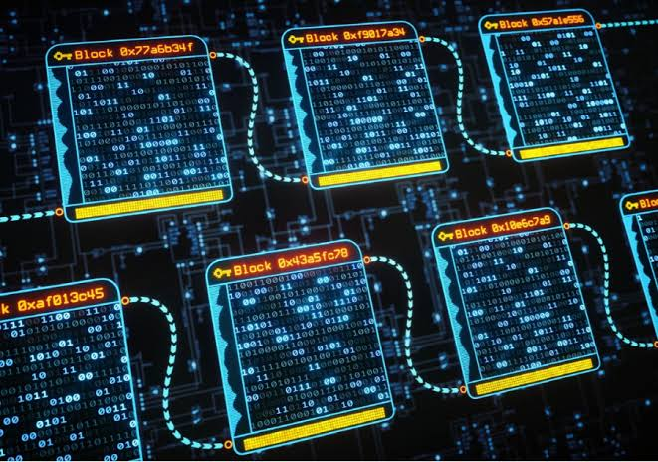
Problem Statement
To create a system which contains unique one-of digital art which cannot be pirated. Also to create contracts(bonds) of physical asset. The transaction history of the asset can be traced ,guaranteeing the security of the record of data and generates trust without the need for a trusted third party. This is implemented by creating an irreversible time line of data in a decentralized nature ,where each block cannot be changed unless specified in the genesis block(root block).

Slide 3
Pain Points
Plagiarism of digital art.
Unauthorized and unverified contracts or bonds for physical assets.
Lack of a market for digital art.
Unclear transaction history.

Slide 4
Project Plan
1. Linked list
2. String matching
3. Sorting
4. Maximum
5. SHA256

Slide 5
Structures
struct nft{
char NFT[50][50];
int cost;
int timestamp;
int nonce;
int nftid;
}
2. struct block{
char hash[64];
char previous_hash[64];
struct nft data;
}
3. Struct wallet{
char walletid[];
int amount;
struct block *NFT;
}

Slide 6
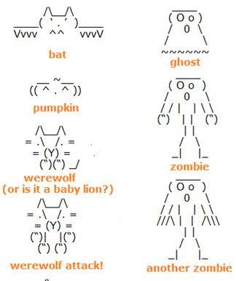
NFT format

Slide 7
Algorithms
Bidding
int bidding()
{
for(i..1 to 10)
{
currbid=(rand()%96)+5;
if(currbid<prevbid)
currbid+=prevbid;
prevbid=currbid;
}
return currbid;
}

Slide 8
Algorithms
create block(struct block block)
{
struct block Newblock= (struct block*)malloc(sizeof(struct block)) ;
Newblock->previous_hash = block->hash;
Newblock->data = block->data;
mineblock(&Newblock);
}

Slide 9
Algorithms
mineblock(struct block *block)
{
*block->hash=sha256(src,sizeof(src),*block->hash) // src->combination of data
while( first 2 digits of hash is not 0)
{
*block->nonce++;
recalculate src
*block->hash=sha256(src,sizeof(src),*block->hash);
}
print(block added)
}

Slide 10
Algorithms
Transaction(struct wallet from, struct wallet to,int nftid)
{
struct block newblock;
while(nftid!=from->nft[i]->data->nftid)
i++
newblock=createblock(from->nft[i]);
add newblock wallet to;
free from->nft->nft;
}

Slide 11
Algorithm
Int stringmatching(hash1,hash2)
{ flag = 0;
for(I 0 to 63)
{
if(hash1[i]!=hash2[i])
flag=1;break;
}
return flag
}

Slide 12
THANK YOU

